Slide 1
CPSC3300: Computer Systems Organization
Lecture 2 – Technology, Performance and Power

Slide 2
Administrivia
Homework 1
To be assigned. Description available on Canvas January 14th
Due Thursday, January 28 11:59pm on Canvas
Reading sections
Chp1.4-6
Zybooks participation activities for 1.1-1.3 due Jan. 19, participation activities for 1.4-1.5 assigned today, due Jan. 21
About late assignments
For each day late there will be a 10% deduction
No late homework assignment submissions accepted once the solution has been made available for that assignment

Slide 3
Overview
Technology
Moore’s law
CPU performance
Elapsed time vs. CPU exec. time
CPU exec. time equation
CPI
Impacting factors
Performance evaluation tools

Slide 4
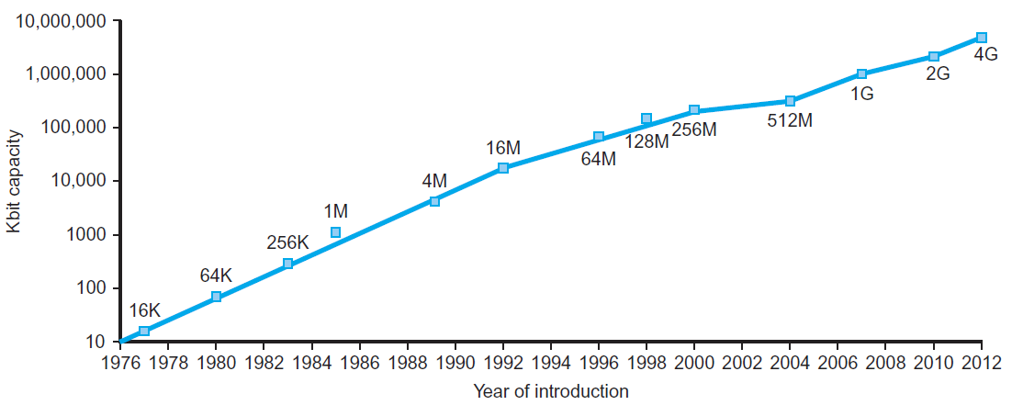
Technology Trends
Electronics technology continues to evolve
Increased capacity and performance
Reduced cost
DRAM capacity
Year | Technology | Relative performance/cost
1951 | Vacuum tube | 1
1965 | Transistor | 35
1975 | Integrated circuit (IC) | 900
1995 | Very large scale IC (VLSI) | 2,400,000
2013 | Ultra large scale IC | 250,000,000,000

Slide 5
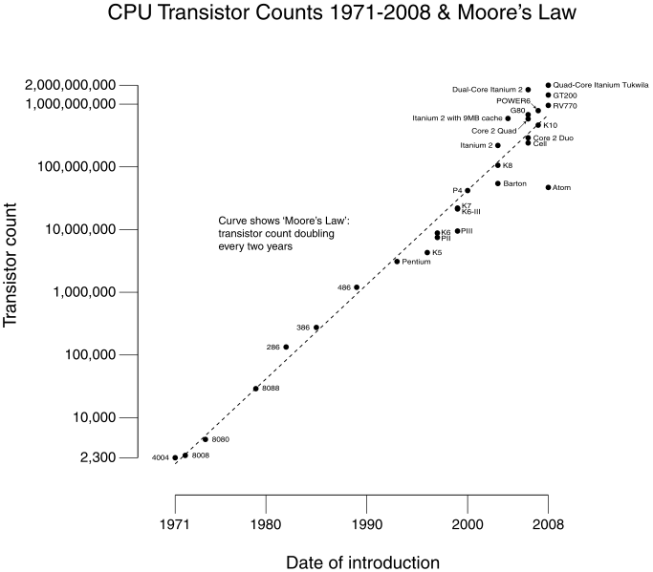
Technology Trends: Microprocessor Capacity
Who is Moore?
“Moore’s Law”
2X transistors/Chip
Every 1.5 years
Growth function?
Trend of transistor’s size?
What is the measure of size?

Slide 6
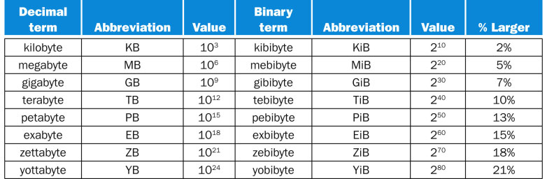
Common Terminology
Capacity of memory and disks
FIGURE 1.1 The 2^{X} vs. 10^{Y} bytes ambiguity was resolved by adding a binary notation for all the common size terms. In the last column we note how much larger the binary term is than its corresponding decimal term, which is compounded as we head down the chart. These prefixes work for bits as well as bytes, so gigabit (Gb) is 10⁹ bits while gibibits (Gib) is 2³⁰ bits.
Copyright © 2014 Elsevier Inc. All rights reserved.
Speed:
KHz, MHz, GHz
KIPS, MIPS, GIPS

Slide 7
Anatomy: 5 components of Computers
Computer
Keyboard, Mouse
Processor
(active)
Memory
(passive)
(where
programs,
data
live when
running)
Devices
Disk (where
programs,
data
live when
not running)
Control
(“brain”)
Input
Datapath
(“brawn”)
Output
Display, Printer
Von Neumann architectures
Notes:
That is, any computer, no matter how primitive or advance, can be divided into five parts:
1. The input devices bring the data from the outside world into the computer.
2. These data are kept in the computer’s memory until ...
3. The datapath request and process them.
4. The operation of the datapath is controlled by the computer’s controller.
All the work done by the computer will NOT do us any good unless we can get the data back to the outside world.
5. Getting the data back to the outside world is the job of the output devices.
The most COMMON way to connect these 5 components together is to use a network of busses.

Slide 8
Inside the Processor (CPU)
Datapath: performs operations on data
Control: sequences datapath, memory, ...
Cache memory
Small fast SRAM memory for immediate access to data

Slide 9
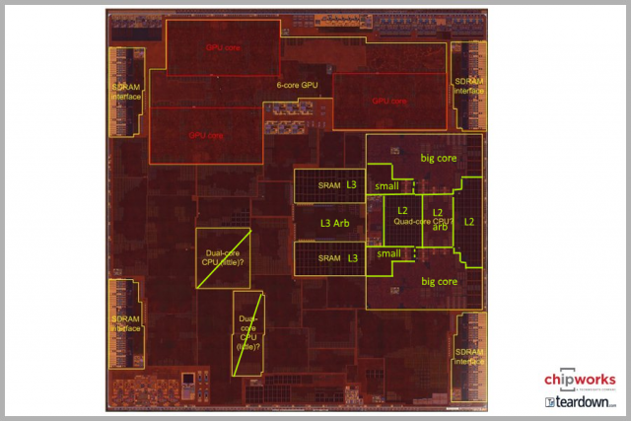
Inside the Processor
Apple A10 die on iphone 7

Slide 10
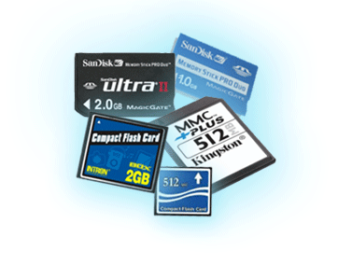
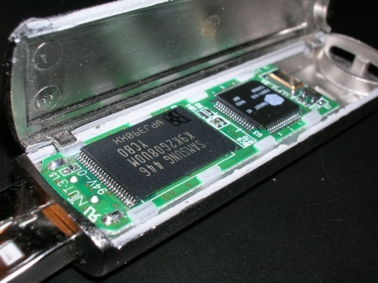
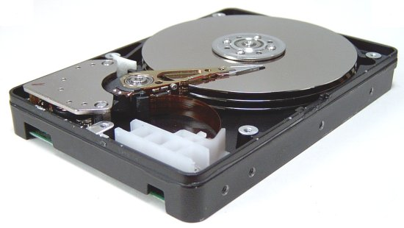
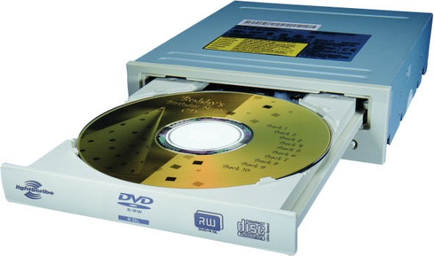
A Safe Place for Data
Volatile main memory
Loses instructions and data when power off
Non-volatile secondary memory
Magnetic disk
Flash memory
Optical disk (CDROM, DVD)

Slide 11
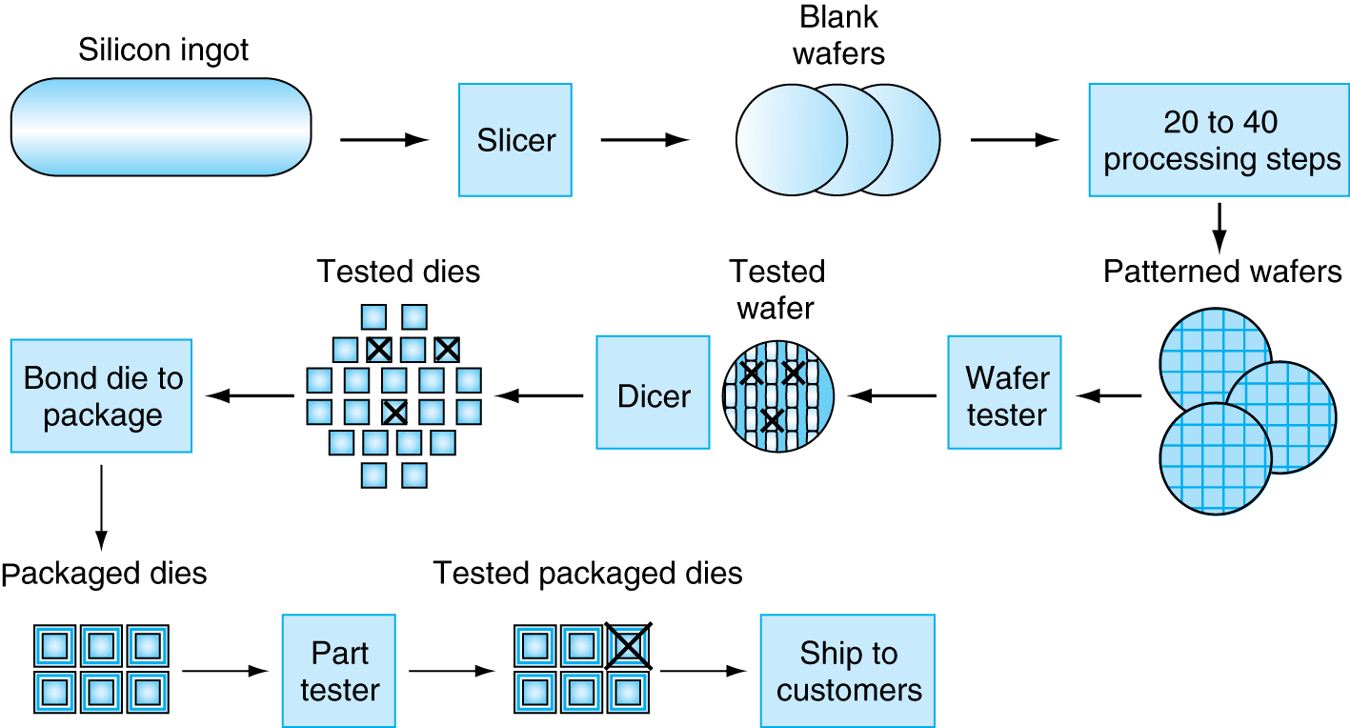
Manufacturing ICs
Yield: proportion of working dies per wafer

Slide 12
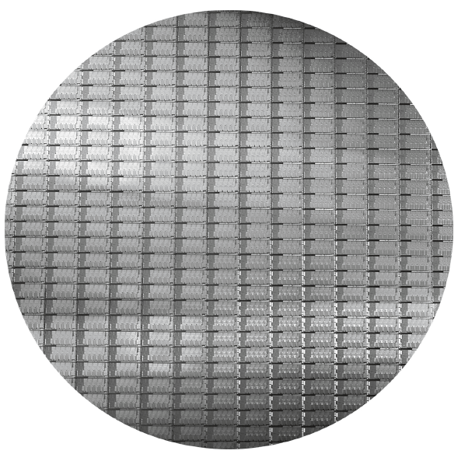
Intel Core i7 Wafer
300mm wafer, 280 chips, 32nm technology
Each chip is 20.7 x 10.5 mm

Slide 13
Integrated Circuit Cost
Nonlinear relation to area and defect rate
Wafer cost and area are fixed
Defect rate determined by manufacturing process
Die area determined by architecture and circuit design

Slide 14
Defining Performance
Performance
Which airplane has the best performance?
What are the measures of processors, or computers?

Slide 15
Response Time and Throughput
Response time
How long it takes to do a task
Throughput
Total work done per unit time
e.g., tasks/transactions/… per hour
How are response time and throughput affected by
Replacing the processor with a faster version?
Adding more processors?
We’ll focus on response time for now…

Slide 16
Relative Performance
Define Performance = 1/Execution Time
“X is n time faster than Y”
Example: time taken to run a program
10s on A, 15s on B
Execution Time_{B} / Execution Time_{A} = 15s / 10s = 1.5
So A is 1.5 times faster than B
What time are they: CPU, or + memory, or + IO?
Or what are the relative times?

Slide 17
Measuring Execution Time
Elapsed time
Total response time, including all aspects
Processing, I/O, OS overhead, idle time
Determines system performance
CPU time
Time spent processing a given job
Discounts I/O time, other jobs’ shares
Comprises user CPU time and system CPU time
Different programs are affected differently by CPU and system performance

Slide 18
Summary
CPU time
Reading for next lecture
5th ed: Chp1.6-8

